Slide 1
Integration testing
Satish Mishra
mishra@informatik.hu-berlin.de

Slide 2
This session
Integration testing
Component / Module testing
  Stub and driver
  Examples
Different approaches to integration testing
  Bottom-up
  Top-down
  Big-bang
  Sandwich
Exercise
  Discussions

Slide 3
What is integration testing
Testing in which software components, hardware components, or both together are combined and tested to evaluate interactions between them
Integration testing usually go through several realword business scenarios to see whether the system can successfully complete workflow tasks
Integration plan specifies the order of combining the modules into partial systems

Slide 4
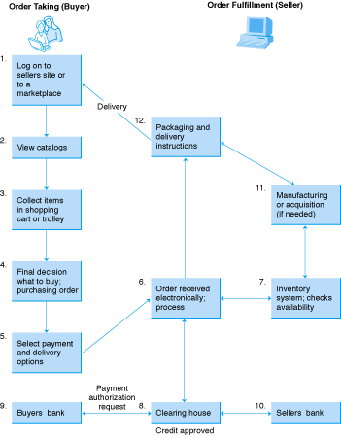
Figure 1-2
Transactions in Electronic Markets

Slide 5
Component / Module testing
A unit is the smallest testable piece of software. A unit is defined as a database trigger, stored procedure, function, report, form, batch load program or PL/SQL program.
Unit testing is the testing that is performed to validate that the unit does satisfy its functional specification and/or that its implementation structure does match the intended design structure.
Module /Component consists of units integrated into a module that performs a specific business function

Slide 6
Testing Activities
Requirements
Analysis
Document
Subsystem
Code
Unit
Requirements
Analysis
Document
System
Design
Document
T
est
Tested
Subsystem
User
Manual
Subsystem
Code
Unit
T
est
Tested
Subsystem
Integration
Functional
Test
Test
Integrated
Subsystems
Functioning
System
Tested Subsystem
Subsystem
Code
Unit
T
est

Slide 7
Drivers and Stubs
Driver: A program that calls the interface procedures of the module being tested and reports the results
  A driver simulates a module that calls the module currently being tested
Stub: A program that has the same interface procedures as a module that is being called by the module being tested but is simpler.
  A stub simulates a module called by the module currently being tested

Slide 8
Drivers and Stubs
Driver
Module
Under Test
Stub
procedure
call
procedure
call

Slide 9
Example 1:
We now consider an example in which we need to develop a "calculator" that converts between different units (e.g., feet to inches).
  We will implement in java !!
  Class UnitConverter
    Method convert
    Method getMultiplier
  Class Driver
    Method main

Slide 10
Soln..
public class UnitConverter
{
public UnitConverter() // Not writing comments since we don’t have place..
{
}
public double convert(double value, String from, String to)
{
double result;
result = value * getMultiplier(from, to);
return result;
}
public double getMultiplier(String from, String to)
{
double multiplier;
multiplier = 1.0;
if (from.equals("inches")) {
if (to.equals("feet")) multiplier = 1.0/12.0;
else if (to.equals("yards")) multiplier = 1.0/12.0/3.0;
else if (to.equals("miles")) multiplier = 1.0/12.0/3.0/1760.0;
} else if (from.equals("feet")) {
if (to.equals("inches")) multiplier = 12.0;
else if (to.equals("yards")) multiplier = 1.0/3.0;
else if (to.equals("miles")) multiplier = 1.0/3.0/1760.0;
} else if (from.equals("yards")) {
if (to.equals("inches")) multiplier = 3.0*12.0;
else if (to.equals("feet")) multiplier = 3.0;
else if (to.equals("miles")) multiplier = 1.0/1760.0;
} else if (from.equals("miles")) {
if (to.equals("inches")) multiplier = 12.0*3.0*1760.0;
else if (to.equals("yards")) multiplier = 1760.0;
else if (to.equals("feet")) multiplier = 3.0*1760.0;
}
return multiplier;
}
}

Slide 11
Soln..
public class Driver
{
public static void main(String[] args)
{
double converted, original;
int i, j;
String from, to;
String[] units = {"inches","feet","yards","miles"};
UnitConverter calculator;
calculator = new UnitConverter();
original = 10.0;
for (i=0; i < units.length; i++) {
for (j=0; j < units.length; j++) {
from = units[i]; // This could be outside the inner loop
to = units[j];
converted = calculator.convert(original, from, to);
System.out.println(original+" "+from+" = "+converted+" "+to);
}
}
}
}

Slide 12
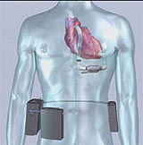
How to test this system ??
Embedded Controller
Analysis
and
Control
Software
Com Port
Heart support device
PatientsDatabase.

Slide 13
Integration testing approaches
Different approaches to integration testing
  Bottom-up
  Top-down
  Big-bang
  Sandwich

Slide 14
Artifacts and Roles for Integration Testing
Test
engineer
Component engineer
Integration tester
System tester
. . . . . . . . . . . . . . . . . . responsible for . . . . . . . . . . . . . . . . . . . . . . . . . . . .
Test evaluation
❒
Use-case model
Test plan
Test procedure
Test component
Defect management
Test case

Slide 15


What we have here…
Developers do everything they can to make the software work.
Testers do everything they can to make the software fail.

Slide 16
Bottom-Up Integration
Only terminal modules are tested in isolation
Modules at lower levels are tested using the previously tested higher level modules
This is done repeatedly until all subsystems are included in the testing
Requires a module driver for each module to feed the test case input to the interface of the module being tested
  However, stubs are not needed since we are starting with the terminal modules and use already tested modules when testing modules in the lower levels
Disadvantage: Tests the most important subsystem last

Slide 17
Bottom-up Integration
A
B
D
C
H
E
F
G
I

Slide 18
Top-down Integration
Only modules tested in isolation are the modules which are at the highest level
After a module is tested, the modules directly called by that module are merged with the already tested module and the combination is tested
Do this until all subsystems are incorporated into the test
Requires stub modules to simulate the functions of the missing modules that may be called
  However, drivers are not needed since we are starting with the modules which is not used by any other module and use already tested modules when testing modules in the higher levels

Slide 19
Top-down Integration
A
B
D
C
H
E
F
G
I

Slide 20
Sandwich Testing Strategy
Combines top-down strategy with bottom-up strategy
The system is view as having three layers
  A target layer in the middle
  A layer above the target
  A layer below the target
  Testing converges at the target layer
How do you select the target layer if there are more than 3 layers?
  Heuristic: Try to minimize the number of stubs and drivers
Top and Bottom Layer Tests can be done in parallel
Does not test the individual subsystems thoroughly before integration

Slide 21
Other Approaches to Integration
Big Bang Integration
  Every module is unit tested in isolation
  After all of the modules are tested they are all integrated together at once and tested

Slide 22
Implementation Approaches
Advantages and Disadvantages
Big bang advantages
  None
Big bang disadvantages
  Difficult to debug
  Much throwaway code
  Critical and peripheral modules not distinguished
  User does not see product until very late in the development cycle

Slide 23
Implementation Approaches
Advantages and Disadvantages
Top-down advantages
  Separately debugged modules
  System test by integrating previously debugged modules
  Stubs are easier to code than drivers
  User interfaces are top-level modules
Top-down disadvantages
  Stubs must be written
  Low-level, critical modules built last
  Testing upper-level modules is difficult

Slide 24
Implementation Approaches
Advantages and Disadvantages
Bottom-up advantages
  Separately debugged modules
  System test by integrating previously debugged modules
  Testing upper-level modules is easier
Bottom-up disadvantages
  Drivers must be written
  Upper-level, critical modules are built last
  Drivers are more difficult to write than stubs
  User interfaces are top-level modules

Slide 25
Summary of testing
Verify operation at normal parameter values
  (a black box test based on the unit’s requirements)
Verify operation at limit parameter values
  (black box)
Verify operation outside parameter values
  (black box)
Ensure that all instructions execute
  (statement coverage)
Check all paths, including both sides of all branches
  (decision coverage)

Slide 26
Summary of testing
Check the use of all called objects
Verify the handling of all data structures
Verify the handling of all files
Check normal termination of all loops
  (part of a correctness proof)
Check abnormal termination of all loops

Slide 27
Summary of testing
Check normal termination of all recursions
Check abnormal termination of all recursions
Verify the handling of all error conditions
Check timing and synchronization
Verify all hardware dependencies
Statements of (Watts Humphrey)

Slide 28
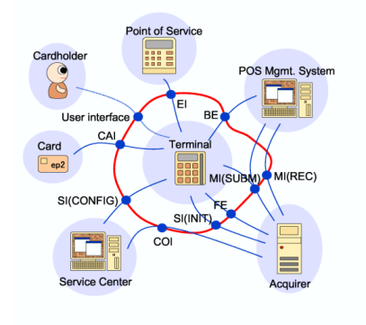
Exercise 2.0
Write the integration test cases for the above system with the consideration of integration approach .

Slide 29
Description
As per the diagram requirement is clear and we should be able to design the system with our knowledge of software engineering.
Consider object / Module oriented design and write the integration test cases for the system.

Slide 30
Thank You

